Slide 1
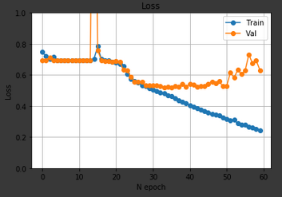
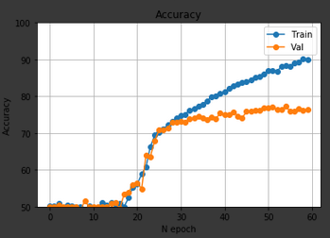
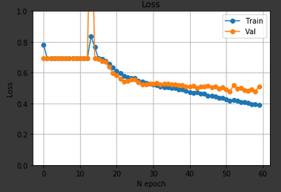
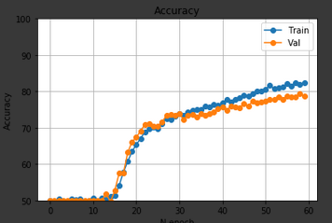
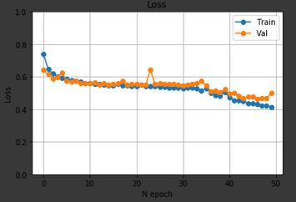
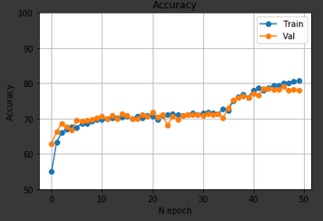
FACE Recognition
Analsis resultats ARTUR PALOMINO
TEST AMB UNA VGG AMB ADAMOPT LR 1E-3, WD 0 BZ 16 N_EPOCH 60 PRETRAINED
BEST EPOCH: 54, BEST TRAIN ACC: 77,3, BEST TEST ACCURACY 76,21
TEST AMB UNA VGG AMB ADAMOPT LR 1E-3, WD 0 BZ 16 N_EPOCH 60 PRETRAINED DATA AUGMENTAT
BEST EPOCH: 58, BEST TRAIN ACC: 79,3, BEST TEST ACCURACY 79,92
TEST AMB UNA VGG AMB ADAMOPT LR 5E-4, WD 0 BZ 16 N_EPOCH 60 PRETRAINED DATA AUGMENTAT
BEST EPOCH: 47, BEST TRAIN ACC: 80,01, BEST TEST ACCURACY 78

Slide 2
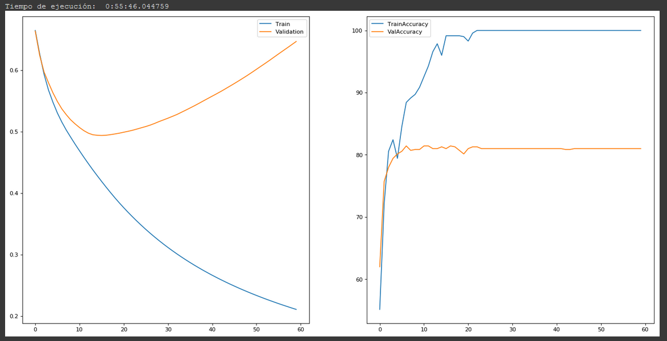
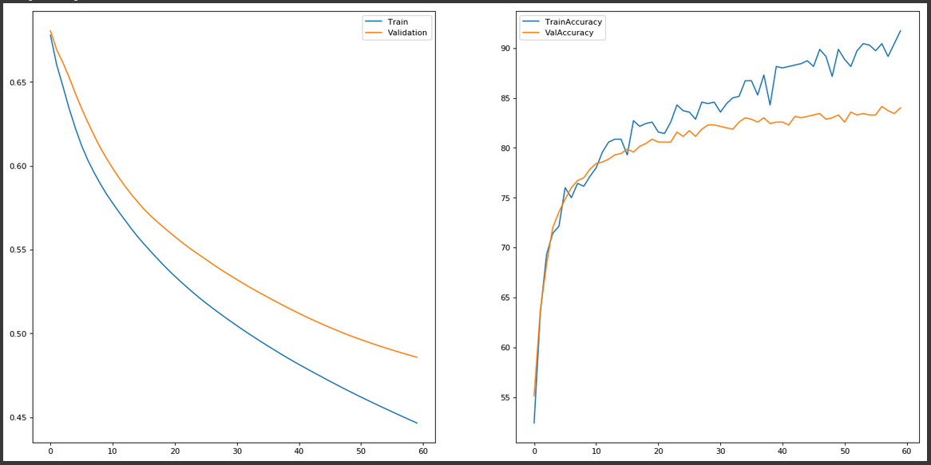
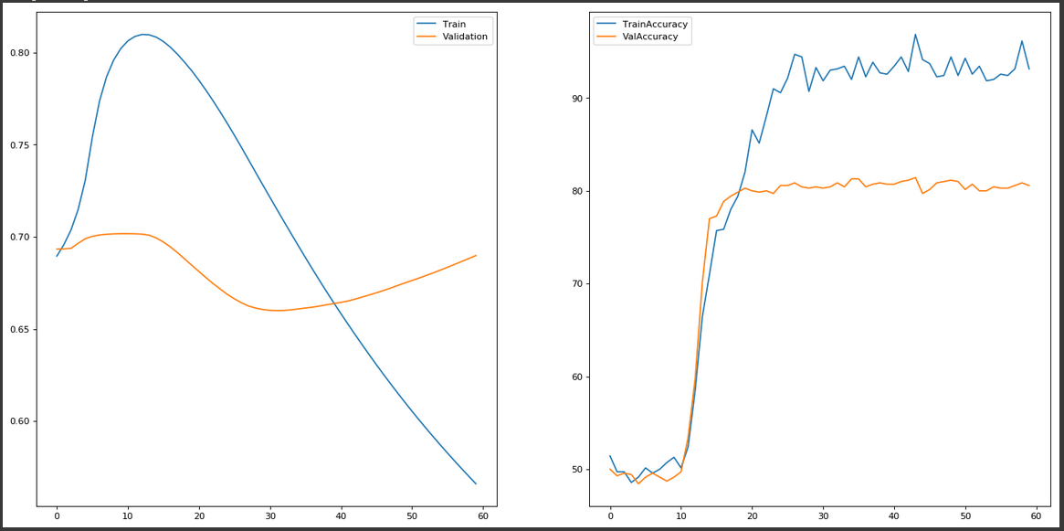
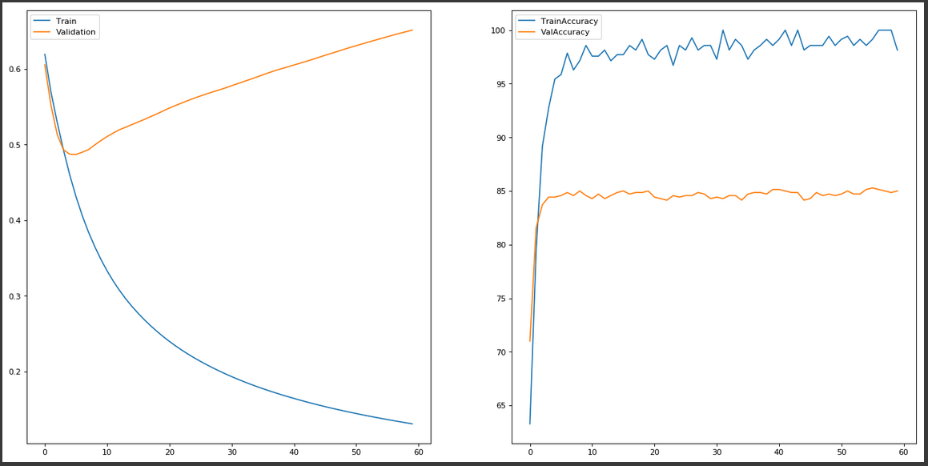
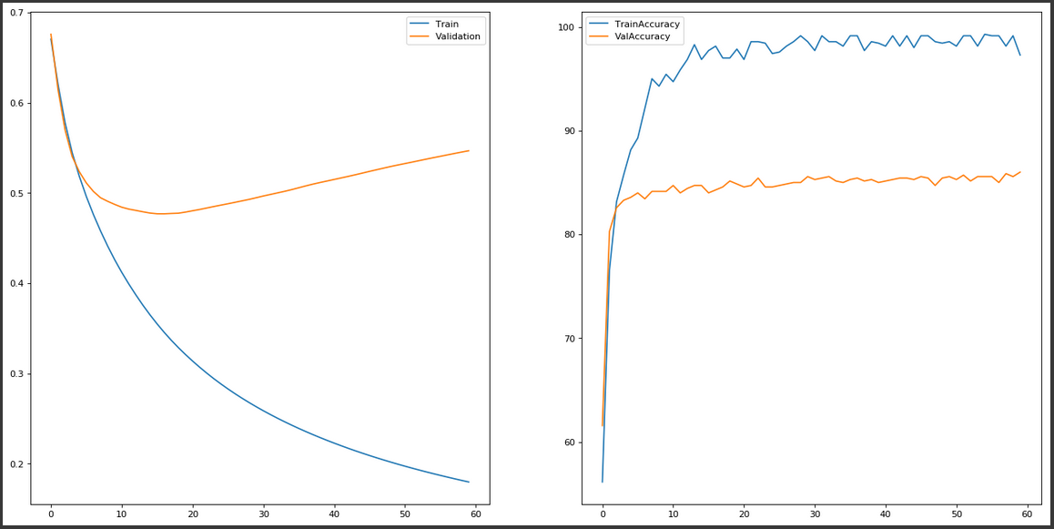
FACE Recognition
OVERFIT
TEST WITH ALEXNET ADAM LR 1E-5, WD 0 BZ 16 N_EPOCH 60
BEST EPOCH: 15, BEST TRAIN ACC: 81, BEST TEST ACCURACY 80
TEST WITH ALEXNET ADAM LR 1E-5, WD 0 BZ 16 N_EPOCH 60 + DATA AUGM
BEST EPOCH: 59, BEST TRAIN ACC: 84, BEST TEST ACCURACY 82
TEST AMB UNA VGG AMB ADAM LR 1E-5, WD 0 BZ 16 N_EPOCH 60
BEST EPOCH: 31, BEST TRAIN ACC: 80, BEST TEST ACCURACY 78
TEST AMB UNA VGG AMB ADAM LR 1E-5, WD 0 BZ 16 N_EPOCH 60 PRETRAINED
BEST EPOCH: 31, BEST TRAIN ACC: 80, BEST TEST ACCURACY 78
TEST AMB UNA VGG AMB ADAM LR 1E-5, WD 0 BZ 16 N_EPOCH 60 PRETRAINED + DATA AUG
BEST EPOCH: 16, BEST TRAIN ACC: 86, BEST TEST ACCURACY 83
OVERFIT
OVERFIT
OVERFIT

Slide 3
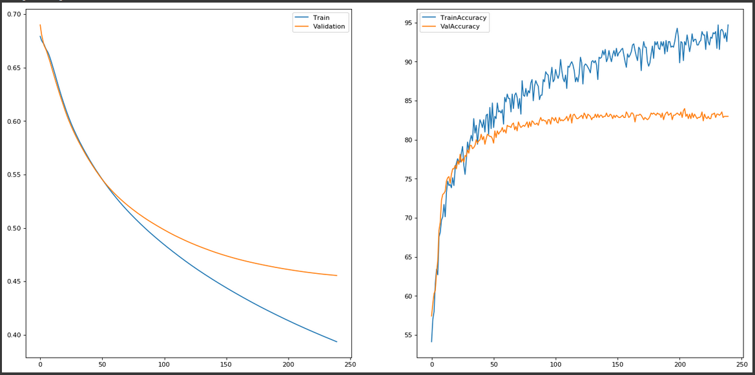
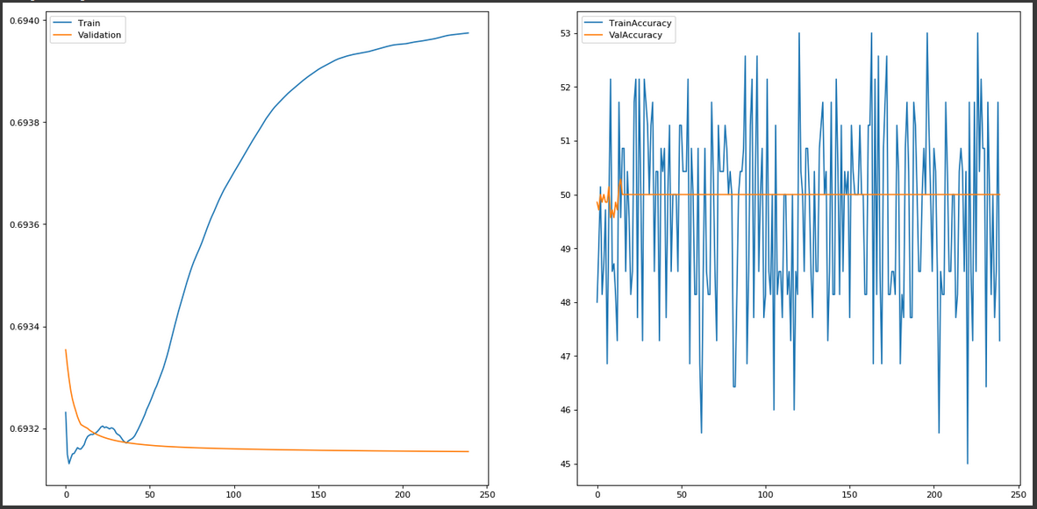
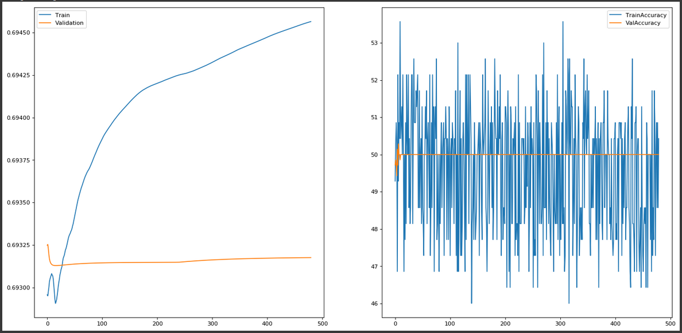
FACE Recognition
TEST WITH ALEXNET ADAM LR 1E-5, WD 0 BZ 16 N_EPOCH 60 + DATA AUGM
BEST EPOCH: 59, BEST TRAIN ACC: 84, BEST TEST ACCURACY 82
TEST WITH ALEXNET ADAM LR 5E-4, WD 0 BZ 16 N_EPOCH 240 + DATA AUGM
BEST EPOCH: 239, BEST TRAIN ACC: 83, BEST TEST ACCURACY 81
TEST WITH ALEXNET ADAM LR 5E-4, WD 0 BZ 16 N_EPOCH 240 + DATA AUGM + PRETRAINED
BEST EPOCH: NONE, BEST TRAIN ACC: 50, BEST TEST ACCURACY 50
TEST WITH ALEXNET ADAM LR 1E-3, WD 0 BZ 16 N_EPOCH 240 + DATA AUGM + PRETRAINED
BEST EPOCH: NONE, BEST TRAIN ACC: 50, BEST TEST ACCURACY 50
TEST WITH ALEXNET ADAM LR 1E-5, WD 0 BZ 16 N_EPOCH 240 + DATA AUGM + PRETRAINED
BEST EPOCH: NONE, BEST TRAIN ACC: 50, BEST TEST ACCURACY 50

